Slide 1
Better Deployment of Airbnb Singapore
Mathai Paul

Slide 2
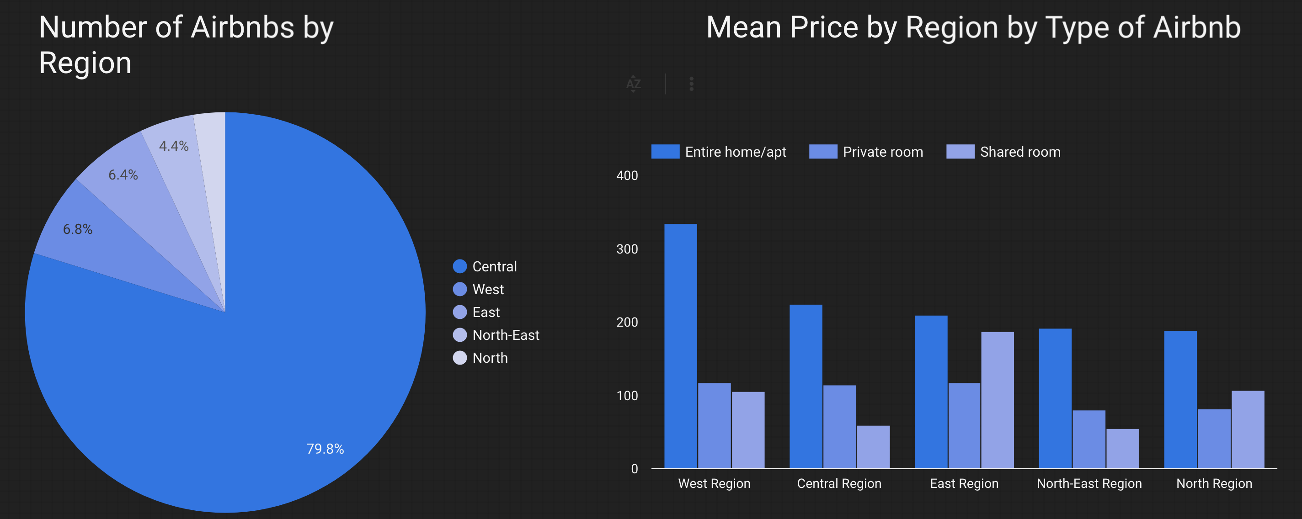
CARE
Low revenue and usage in central regions
Lack of availability in non-central regions where mean price is mostly low.

Slide 3
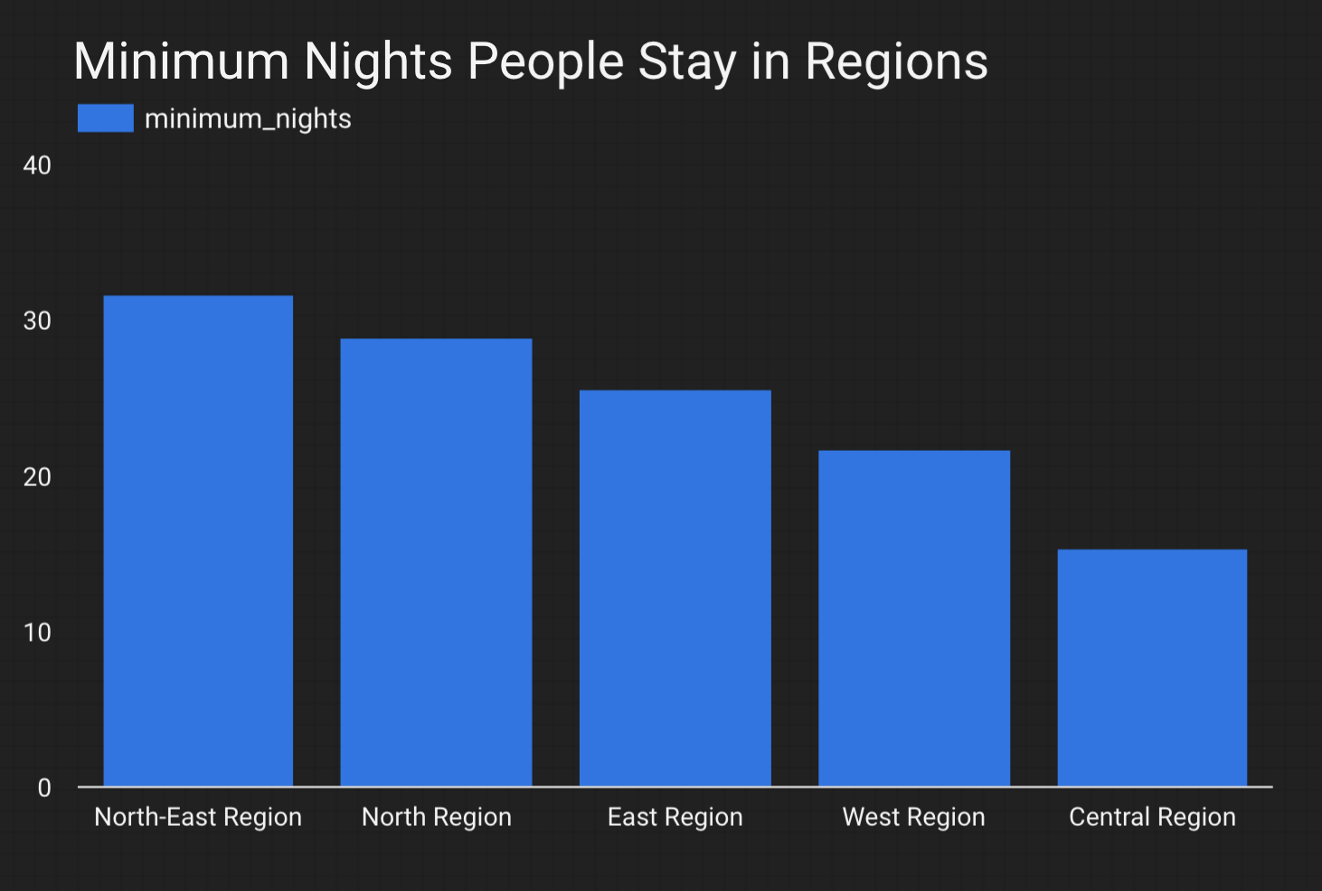
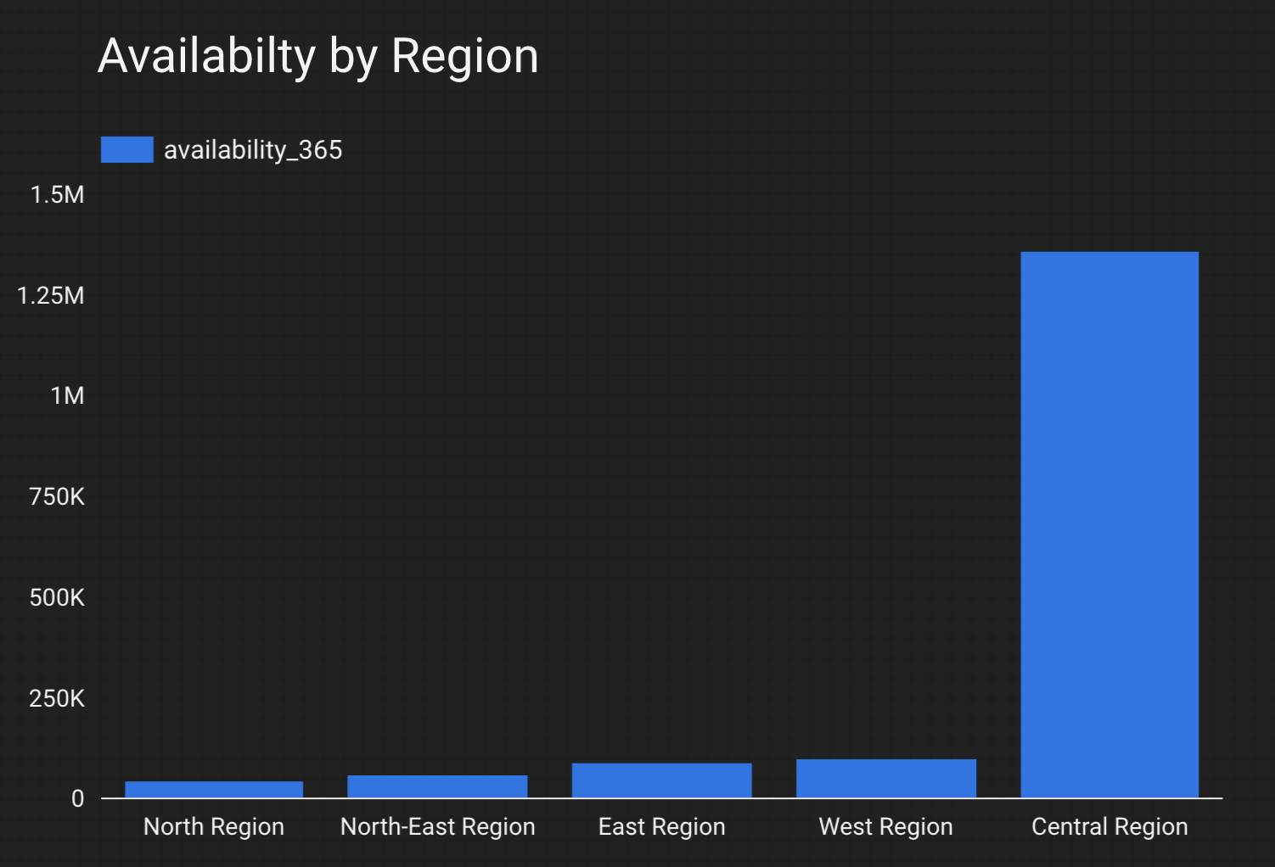
CARE
People stay for longer in non-central regions
Lack of availability in non-central regions

Slide 4
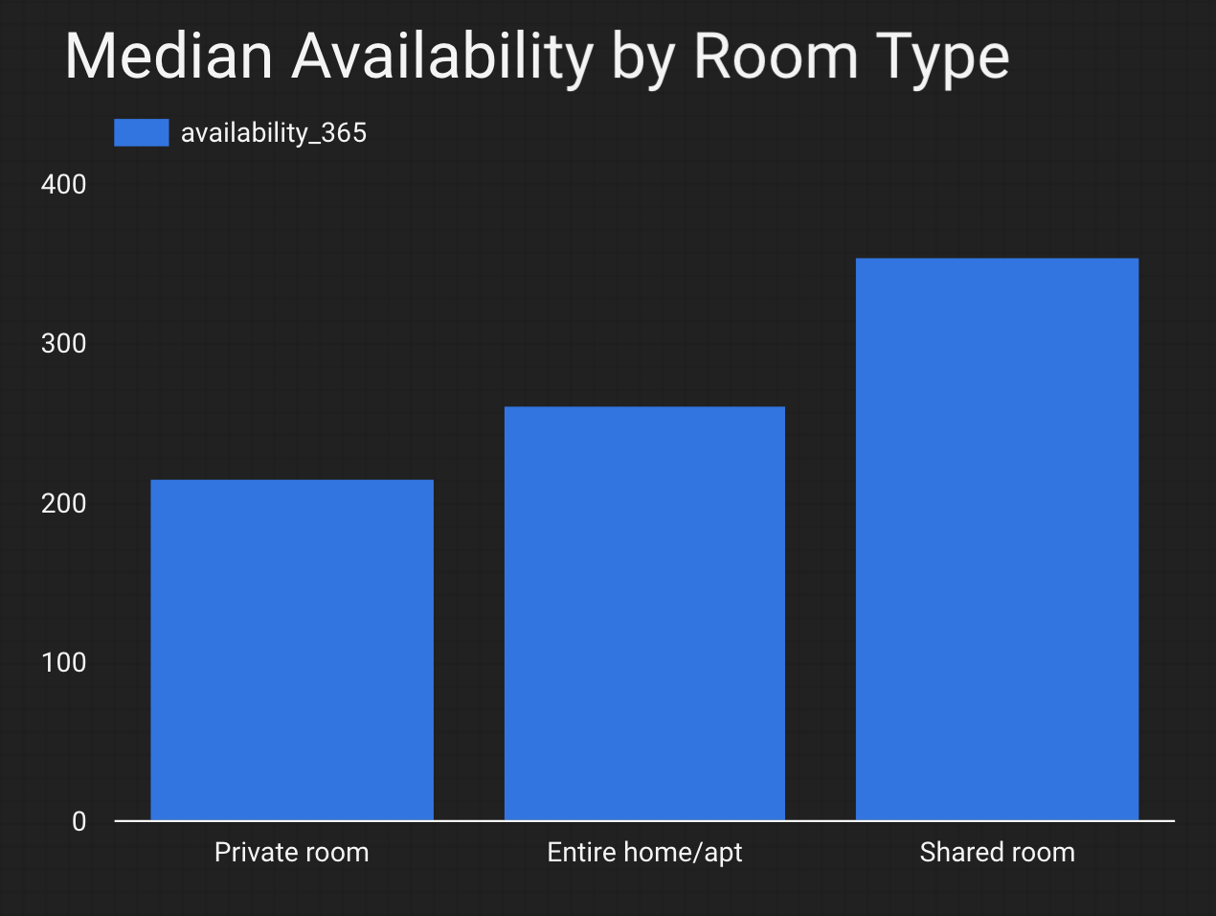
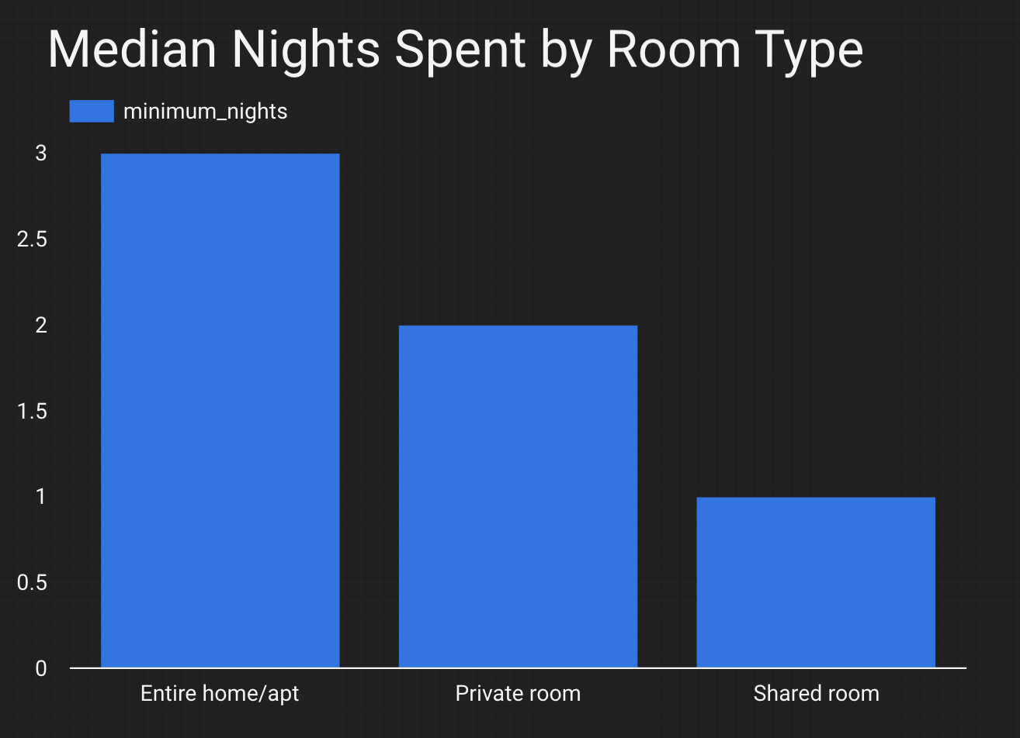
CARE
People spend more nights at home/apartment and private rooms
Lack of availability of private rooms and home/apartment

Slide 5
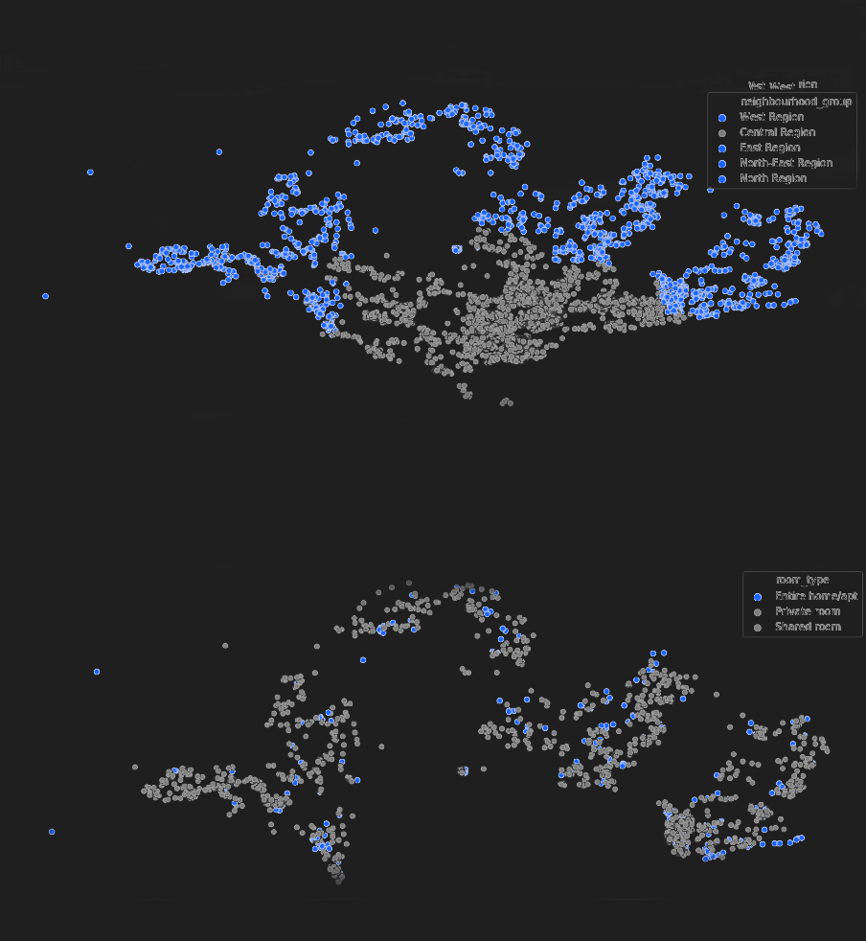
DO
Increase the number of Airbnb's in non-central regions

Slide 6
DO
Specifically increase the number of entire house/apartment Airbnb’s in non-central regions
Especially the western region.

Slide 7
IMPACT
Increase revenue by more than 20% by doubling the number of options in Non-Central regions.
Increase the availability of properties by distributing the demand over the regions for more customers.
More properties in non-central regions would increase the number of nights people stay.

